Slide 1

HOT TUB TOUR!
If an adventurous group of people wanted to take a five-day whirlwind tour of the greatest hot tub locations across California, where would they go??? Our research data* and analysis will provide them the information they need to accomplish this.
STRATEGY
1
What percentage of hot tubs are in each rating category?
Presented by
Leah Nash
Isabella Taylor
Philip Jaques
Steve Reed
CONCEPT
PROMOTE
2
Is Northern or Southern California the most desirable region?
3
What are the best locations by review category?
Research Questions
4
What are the price ranges for people with different budgets?
*Airbnb data source: http://insideairbnb.com/get-the-data/

Slide 2




HOT TUB TOUR!
If an adventurous group of people wanted to take a five-day whirlwind tour of the greatest hot tub locations across California, where would they go??? Our research data* and analysis will provide them the information they need to accomplish this.
STRATEGY
1
What percentage of hot tubs are in each rating category?
Presented by
Leah Nash
Isabella Taylor
Philip Jaques
Steve Reed
CONCEPT
PROMOTE
2
Is Northern or Southern California the most desirable region?
3
What are the best locations by review category?
Research Questions
4
What are the price ranges for people with different budgets?
*Airbnb data source: http://insideairbnb.com/get-the-data/

Slide 3

What percentage of hot tubs are in each rating category?
Most of the Airbnb’s fall within the 4 and 5-star categories. 4-star Airbnb’s are far more prevalent and account for just over 73% of the properties.
STRATEGY
DEVELOP
PROMOTE

Slide 4
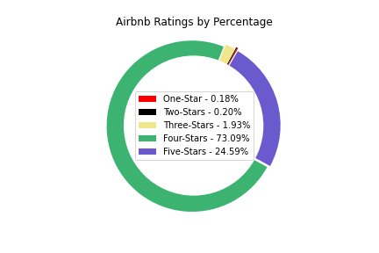

Slide 5
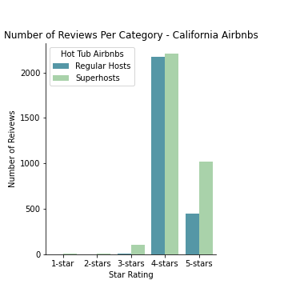

Slide 6
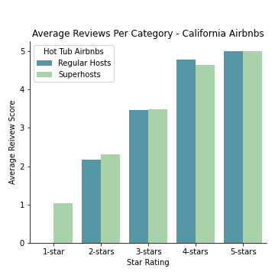

Slide 7
Is Northern or Southern California the most desirable region?
Based on the observations, Southern California is the more desirable vacation destination if you are looking for an ideal hot tub Airbnb stay.
With 174 private hot tub, super-hosted, five-star Airbnb’s, Southern California far exceeds the 24 locations presented in Northern California.
NORTHER CALIFORNIA
SOUTHERN CALIFORNIA
Notes:
ISABELLA

Slide 8
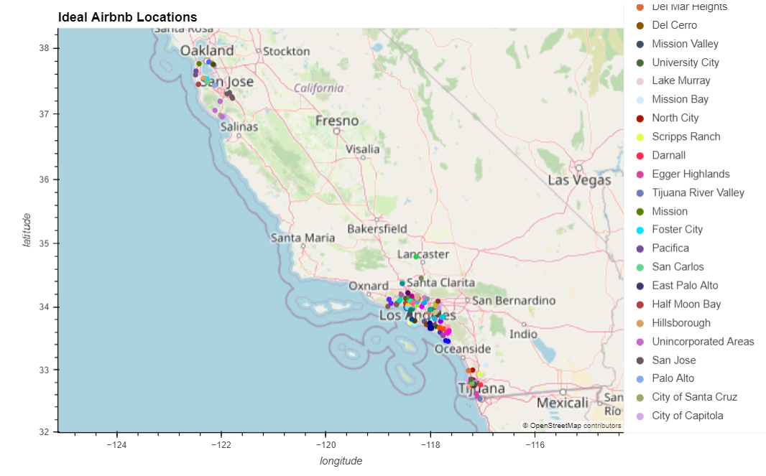

Slide 9
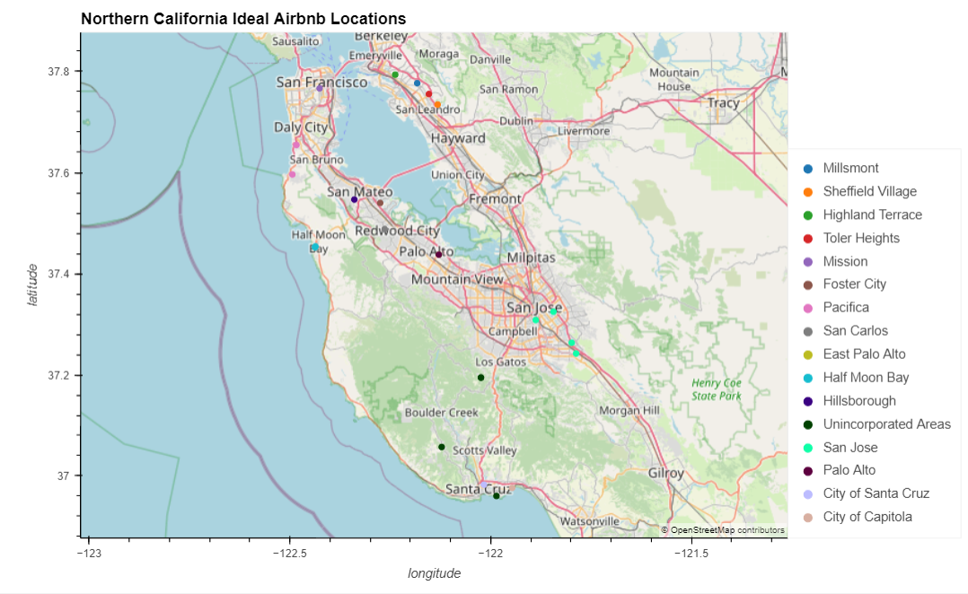

Slide 10
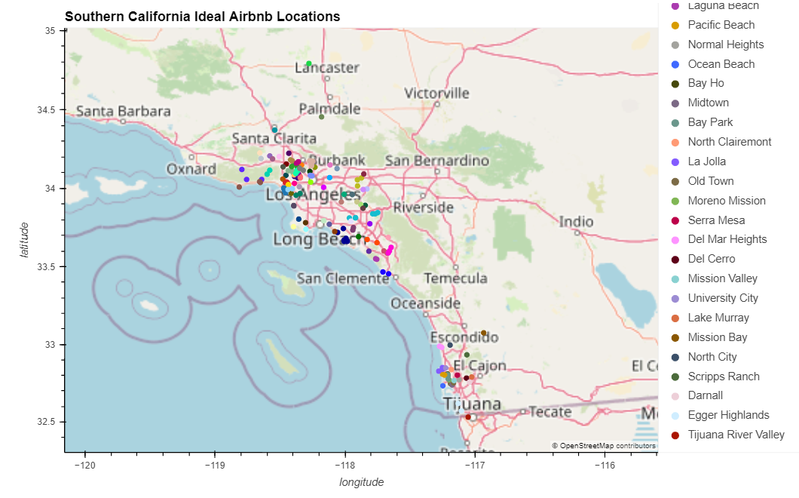

Slide 11

What are the best locations by review category?
The data shows the highest rated review categories are Location and Communication. People most enthusiastically rate those categories in Southern California.
CHECK IN
COMMUNICATION
CLEANLINESS
LOCATION
4.87
4.88
4.78
4.87
ACCURACY
VALUE
4.74
4.83

Slide 12
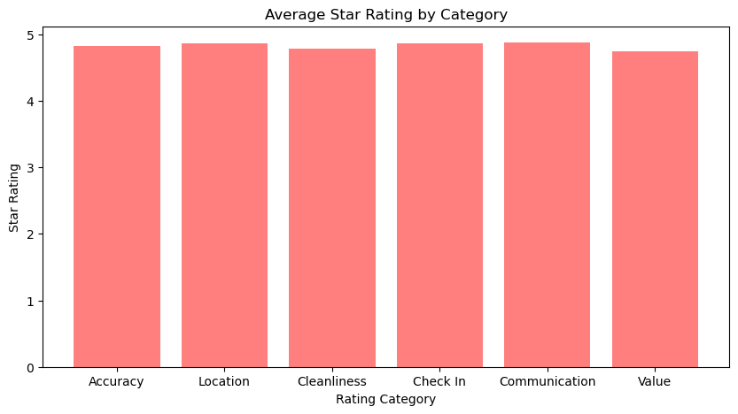

Slide 13
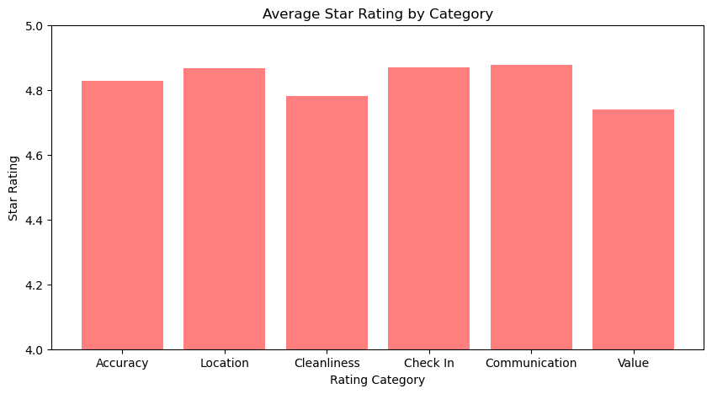
ENHANCE!!!

Slide 14
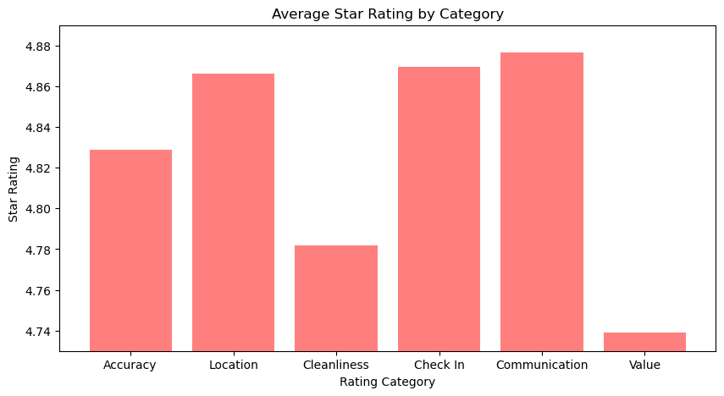
MORE ENHANCE!!!

Slide 15
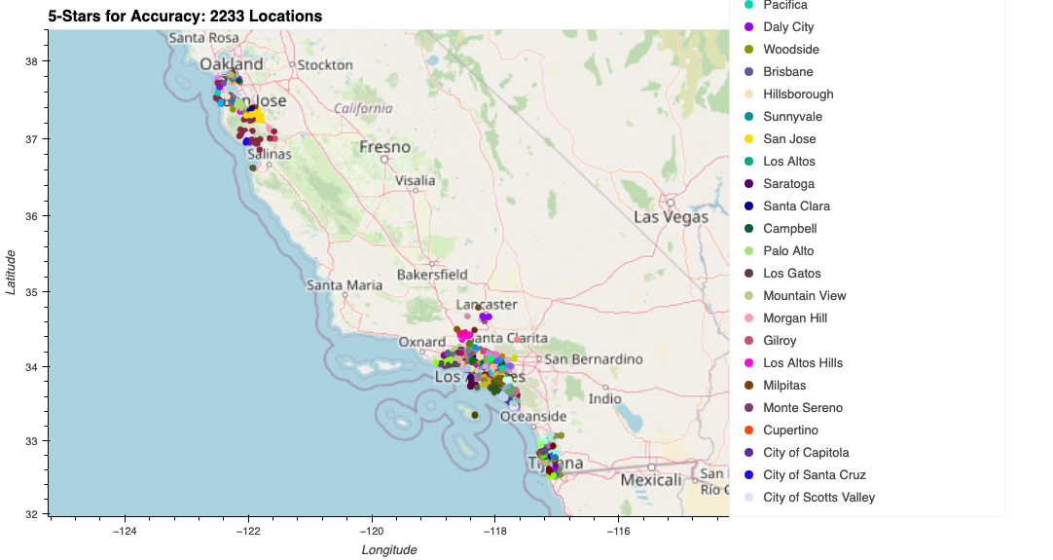

Slide 16


Slide 17
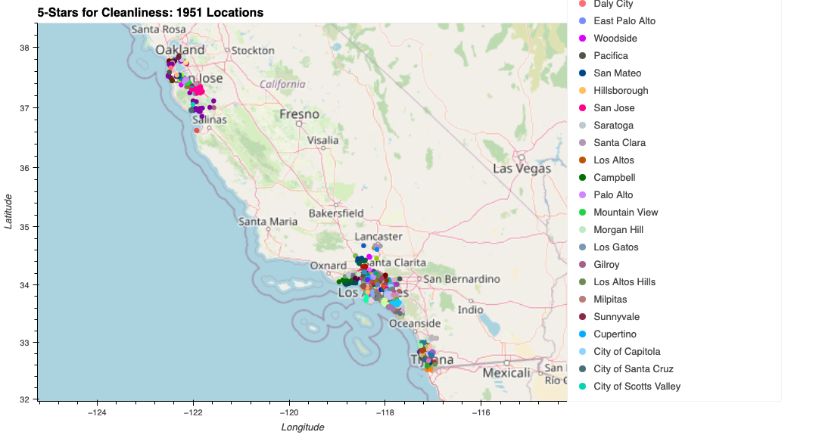

Slide 18
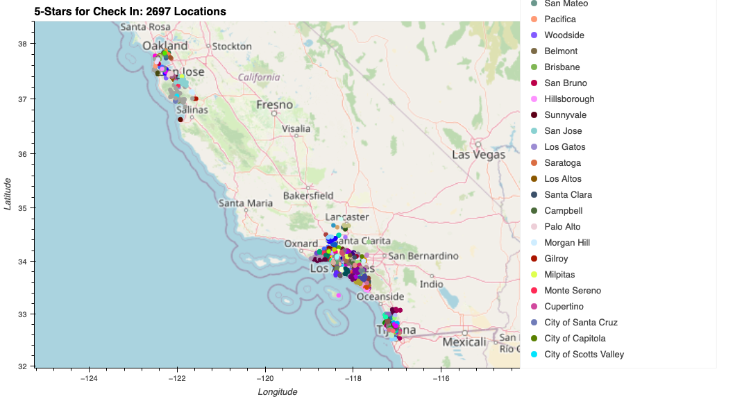

Slide 19
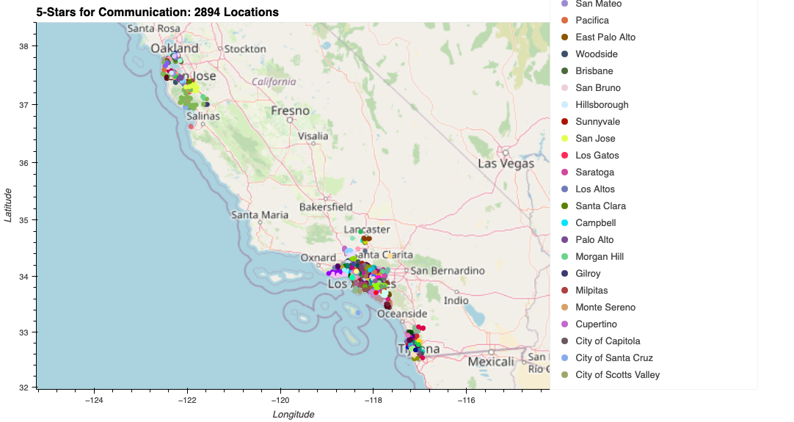

Slide 20
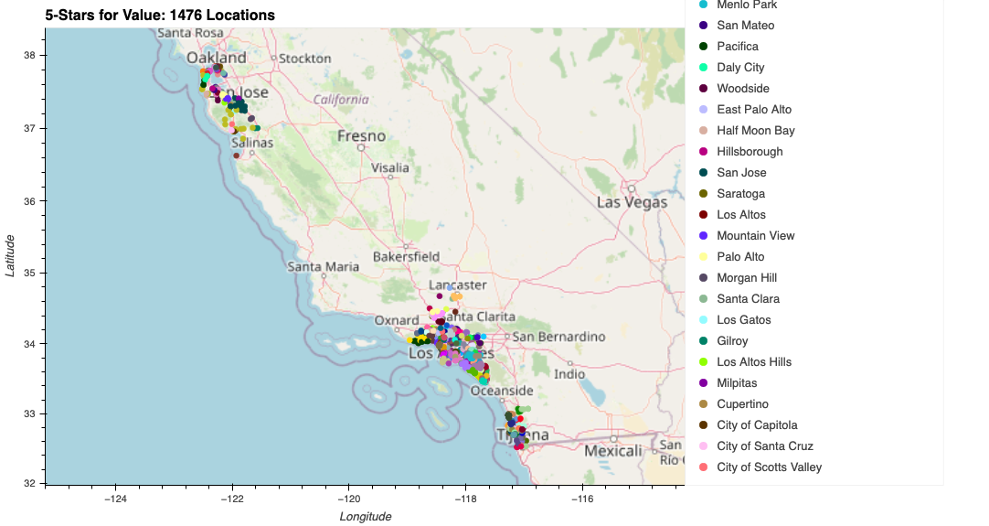

Slide 21
What are the price ranges for people with different budgets?
Overall, there are significantly more Airbnb's in the $0-500 range, accounting for 78.9% of all hot tub Airbnb's in Northern and Southern California.
The pricier the Airbnb's get, the less prominent they become.
13% of all hot tub Airbnb’s are in the $500-1,000 range.
7.8% of hot tub Airbnb's cost $1,000-5,000.
0.3% of the Airbnb's cost $5,000-10,000.
0.1% of all hot tub Airbnb's are in the price range of $10,000-30,000.

Slide 22
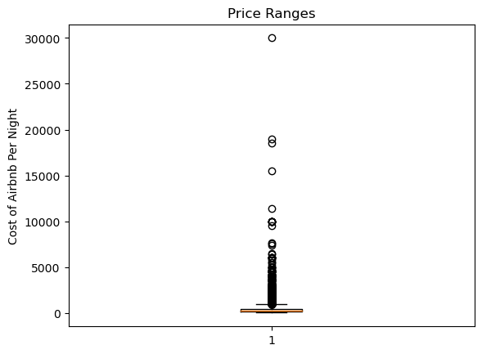

Slide 23
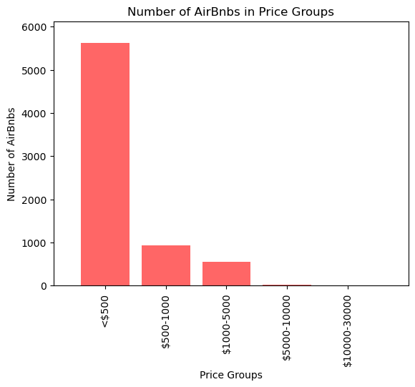

Slide 24
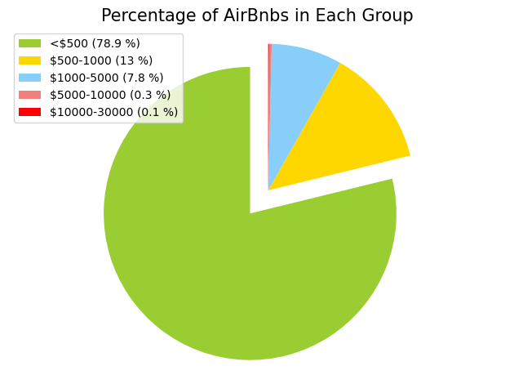

Slide 25
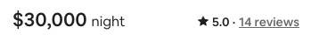
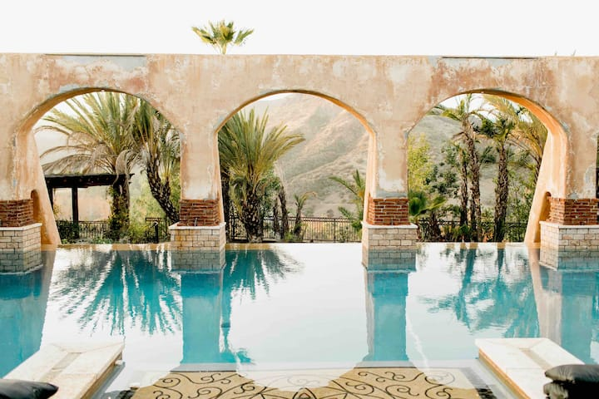

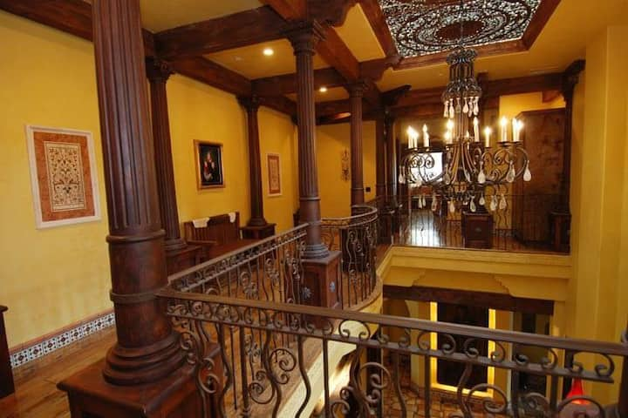
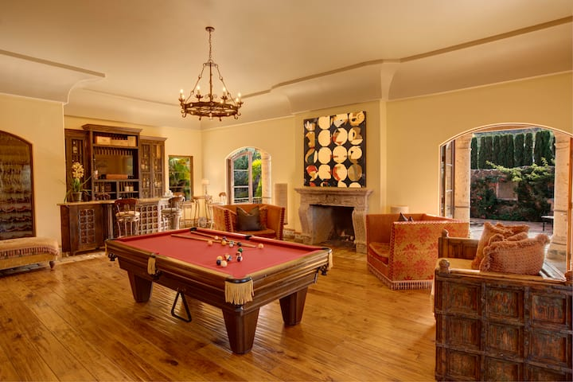
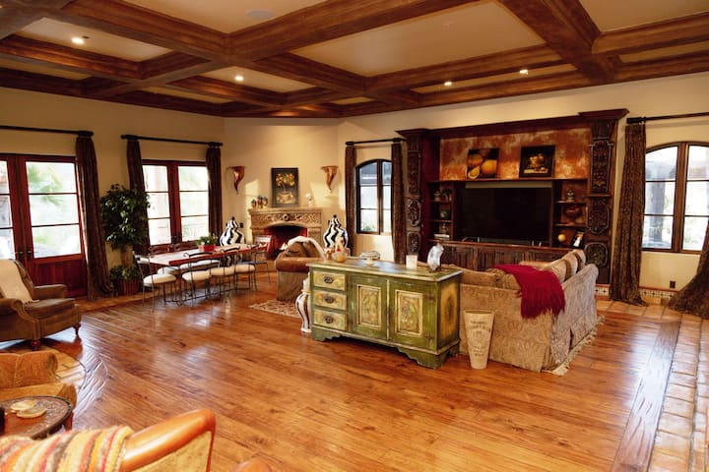
Villa de la Vina
The Vineyard Villa

Slide 26
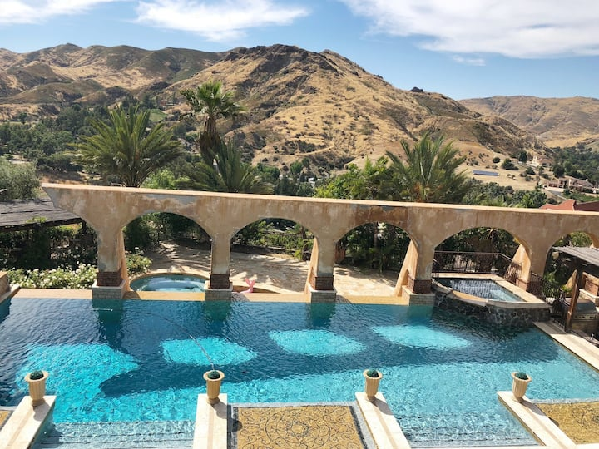
Villa de la Vina
The Vineyard Villa
BONUS HOT TUB!
….but what about the Hot Tub???

